Slide 1





Employee Data Analysis using Excel
STUDENT NAME: SATHIYA PRIYA R
REGISTER NO: 312211573
DC72DCE3408B520AB874E7B474A3BFB9
DEPARTMENT: B.COM BANK MANAGEMENT
COLLEGE : THIRUTHANGAL NADAR COLLEGE
1

Slide 2





PROJECT TITLE
Employee Performance Analysis using Excel
1

Slide 3





AGENDA
Problem Statement
Project Overview
End Users
Our Solution and Proposition
Dataset Description
Modelling Approach
Results and Discussion
Conclusion
3/21/2024 Annual Review
2

Slide 4










PROBLEM STATEMENT
Obectives: to analyse and generate insights from employee data to improve workforce management and decision-making.
Dataset: you have been provided with an excel dataset containing the following columns:
1.Employee id
2.Name
3.Department
4.Date of birth
5.Position
6.Date of hire
7.Salary
8.bonus
9.House worked per week
10.Performance rating
3

Slide 5

PROJECT OVERVIEW
Objective: to analyse employee data to derive actionable insights for enhancing organizational performance , optimizing resource allocation , and informing strategic HR decisions.
Scope: this project involves examining various aspects of employee data, including demographics, employment history, compensation, and performance the analysis will focus on, and patterns that can aid in making informed HR decisions.
Stakeholders: HR Department, Management Team, Data Analysis Team
Success Criteria:
1.Accurate and thorough data analysis
2.Clear and actionable insights
3.Effective visualizations that facilitate understanding of data trends.
4

Slide 6

WHO ARE THE END USERS?
Owner
Management
Human resources
Employee
Company
5

Slide 7

OUR SOLUTION AND ITS VALUE PROPOSITION
Conditional formatting - highlight blanks
Filter - remove blanks
Formula - performance analysis
Pivot table - summarize information
Graph - data visualization
6
Notes:
1.7.2013
1.7.2013
6
‹#›
‹#›

Slide 8
Dataset Description
Employee Dataset - From Edunet Dashboard
Available Features - 26
Necessary Features - 9
Employee Id - In Number
Name - In Text
Performance Level - In Text
Gender - Male,Female
Employee Rating - In Numerical Value

Slide 9

THE "WOW" IN OUR SOLUTION
Performance Level Analysis=IFS(Z8>=5,”VERY HIGH”,Z8>=4,”HIGH”,Z8>=3,”MED”,TRUE,”LOW”)
3/21/2024 Annual Review
8

Slide 10
MODELLING
Data collection:
1.To gather comprehensive and accurate employee data that will serve as the foundation for analysis aimed at improving hr and management decisions.
2.verify the accuracy and completeness of the data
Feature collection:
1.to identify and collect relevant features (Data attributes) that will be used in the analysis of employee data to extract meaningful insights and support decision-making.
2.review the collected features and select those that are most relevant to the analysis objectives.
Data cleaning:
1.to prepare the employee dataset by correcting errors, handling missing values, and ensuring consistency to enable accurate and reliable analysis.
2.A cleaned and well-organised dataset that is free from errors, inconsistencies, and missing values, ensuring reliable and accurate analysis.
Perfomance level:
1.track performance changes over time to identify pattens or impovements.
2.assess if employees are meeting performance goals and targets over specified periods.
9

Slide 11
Summary:
1.to provide a concise overview of the findings and insights derived from the analysis of employee data, aiding hr and management in making informed decisions.
2.this summary consolidates the findings from employee data analysis into an accessible format, enabling effective communication of insights and recommendations to stakeholders.
Visulaization:
1. for basic charts and graphs such as bar charts, line charts, and histograms.
2.ensure that visualizations are clear and easy to understand, avoiding clutter and focusing on key insights.

Slide 12
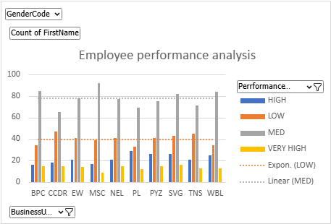
RESULTS
11

Slide 13
conclusion
The analysis provides a comprehensive overview of employee performance, compensation, and demographic trends, offering actionable insights to enhance hr practices and organisational performance.
Performance distribution:
the analysis reveals that performance ratings are generally concentrated kin the mid-range, with a small percentage of employees rated at the extremes (high or low).

